Slide 1
Lead Score case Study
Submitted By:
Anil Kumawat
Lijo C Jacob
Lijin L

Slide 2
Contents:
Problem Statement
Problem Approach
Model Evaluation
Observation
Conclusion

Slide 3
Problem Statement
The education company, X Education, wants to identify the most potential leads so that their Sales team can focus more on communicating with these potential leads in order to successfully convert them.

Slide 4
Problem Approach
We are taking Logistic Regression model to evaluate which feature is more suitable to predict and achieve the business objective.
Starting with Data importing we did complete EDA on the data set to clean and keep the important feature and categorical variables to see Coefficient and Correlation among the dataset.
After the splitting train and test part we have built a regression model by eliminating high VIF values and run the model to see the Accuracy of the model.

Slide 5
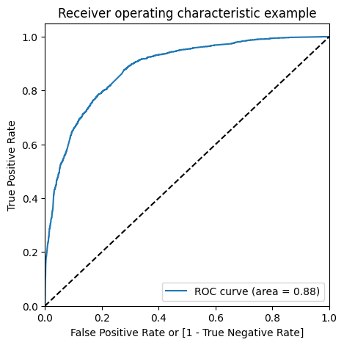
Model Evaluation
Model is evaluated on the basis of the VIF and features we got at the end.
Based on our evaluation we have got ROC curve of 0.88.

Slide 6
Conclusion:
As per our observation we have concluded that top 3 categorical values are :
Last Activity Had a Phone Conversation
Last Activity Converted to Lead
Occupation Working Professional

